Slide 1

CBI’S Directory
(Central Bank of India )

Slide 2
Introduction
A bank is a financial institution which accepts deposits, pays interest on pre-defined rates, clears checks, makes loans, and often acts as an intermediary in financial transactions. It also provides other financial services to its customers. Bank Database management system is used to collect, modify and retrieve data of the customers who has account in their bank. Bank Database stores all the information in the form of tables according to its type . Bank database contains five tables customer, account, branch, trandetails and loan.

Slide 3
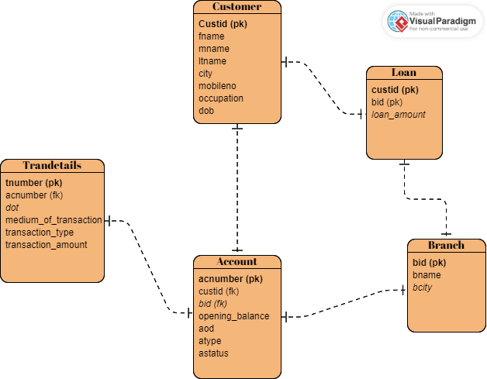
ER-Diagram

Slide 4
STRUCTURE OF TABLE

Slide 5
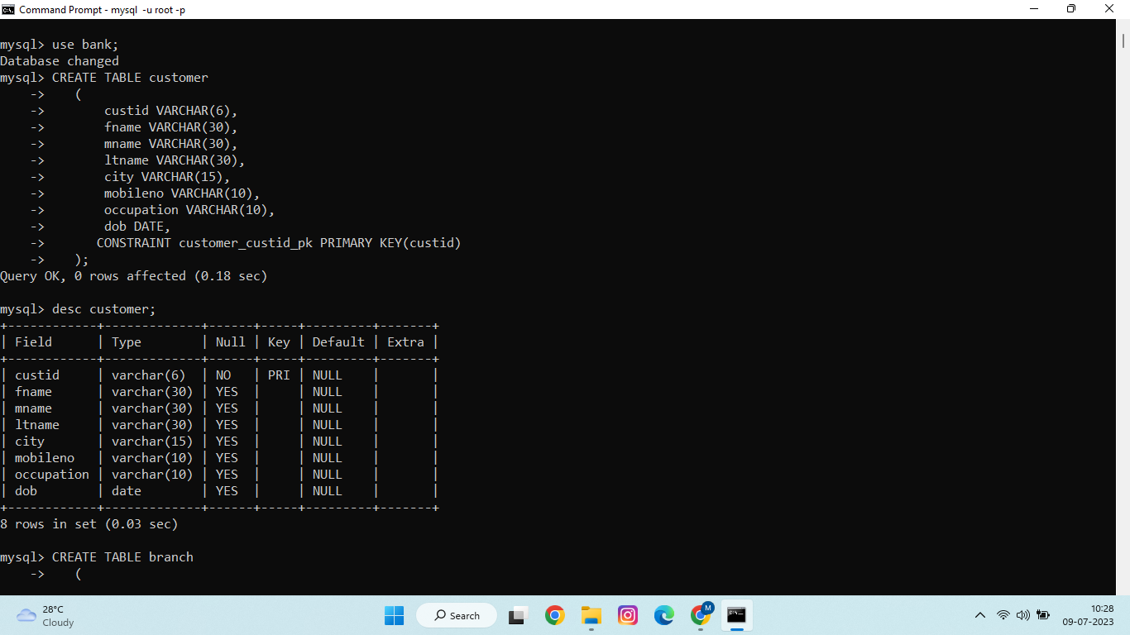
CUSTOMER:

Slide 6
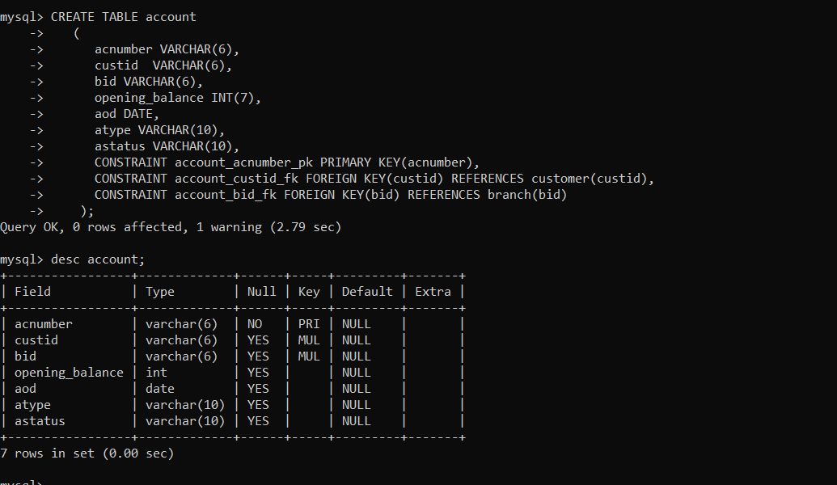
ACCOUNT:

Slide 7
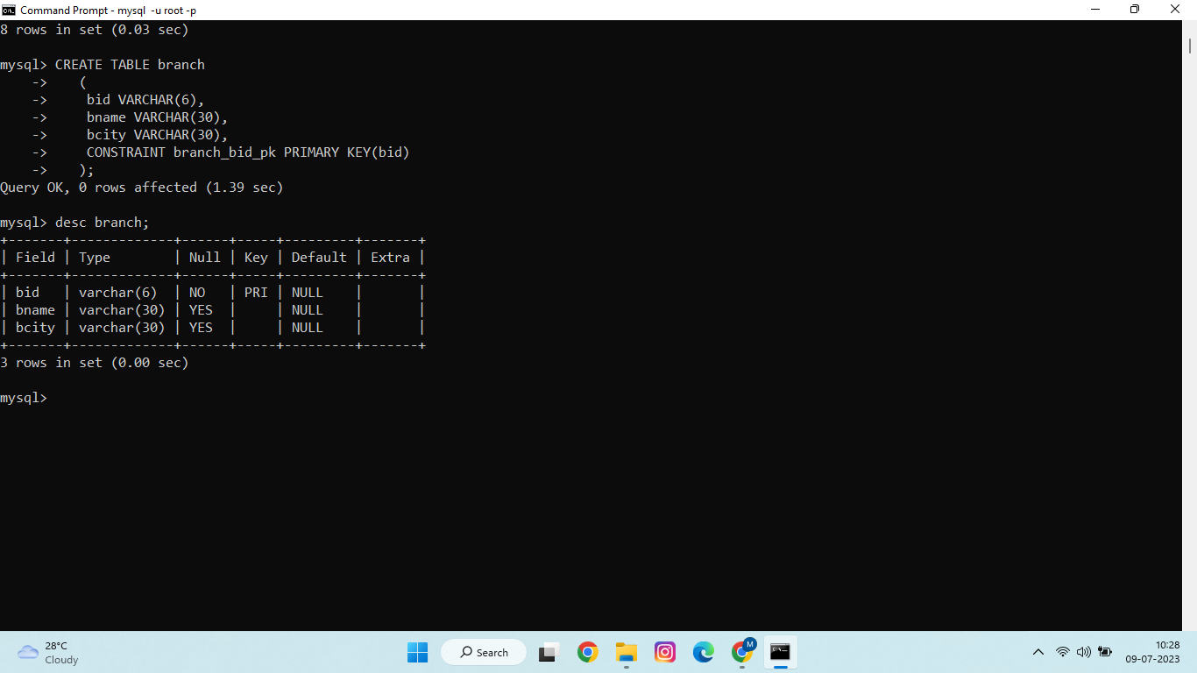
BRANCH:

Slide 8
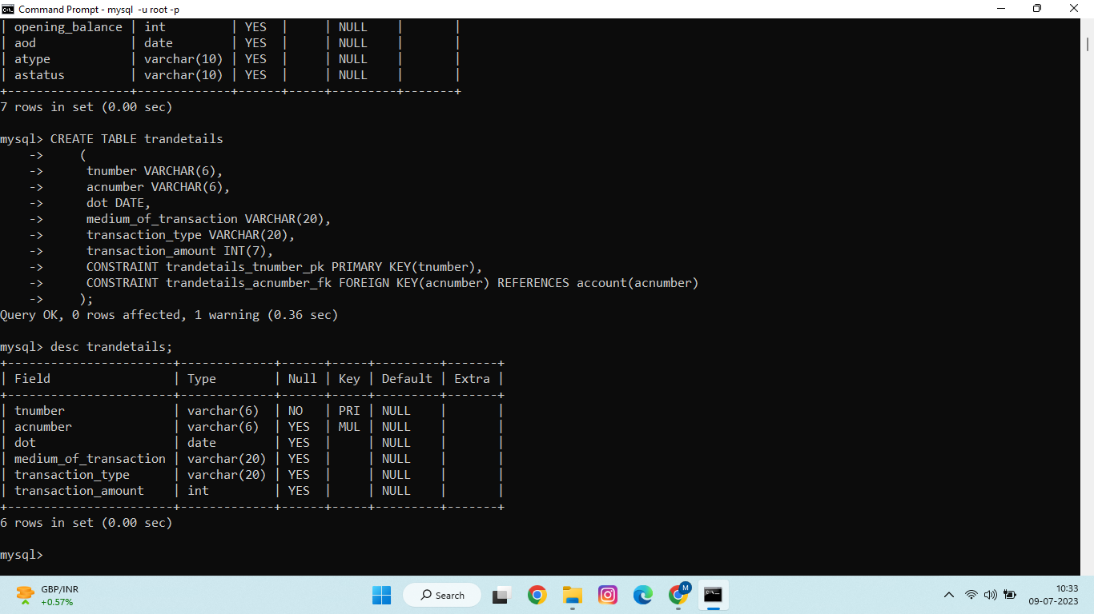
TRANDETAILS:

Slide 9
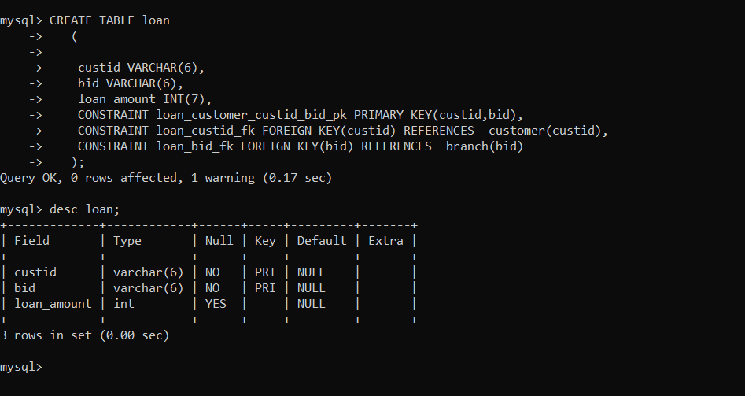
LOAN:

Slide 10
CONTENT OF TABLES:

Slide 11
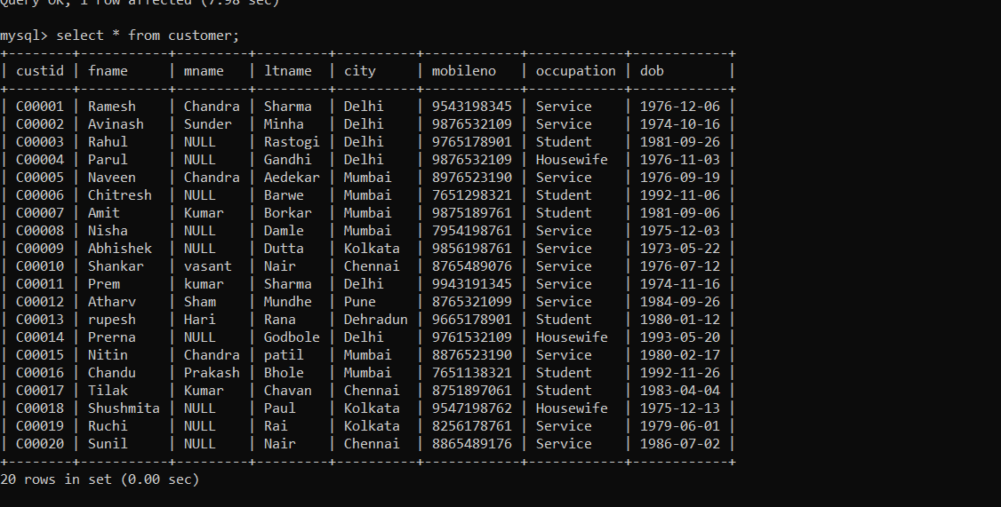
Customer:

Slide 12
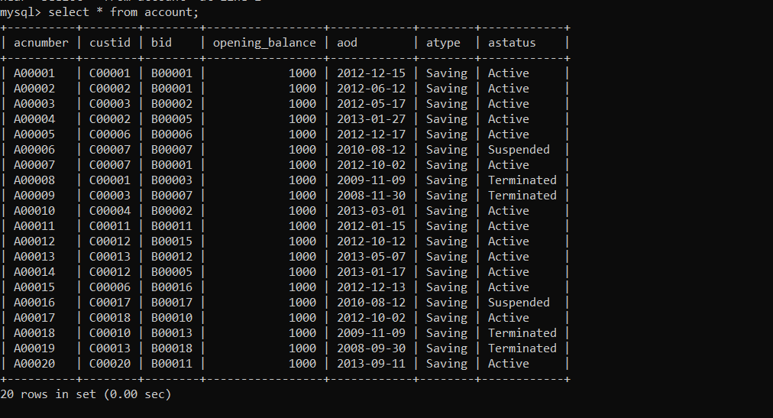
Account:

Slide 13
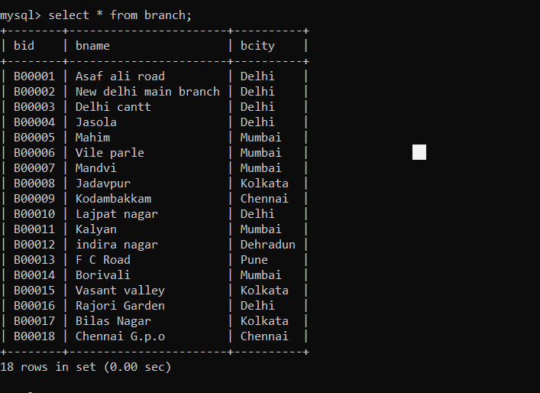
Branch:

Slide 14
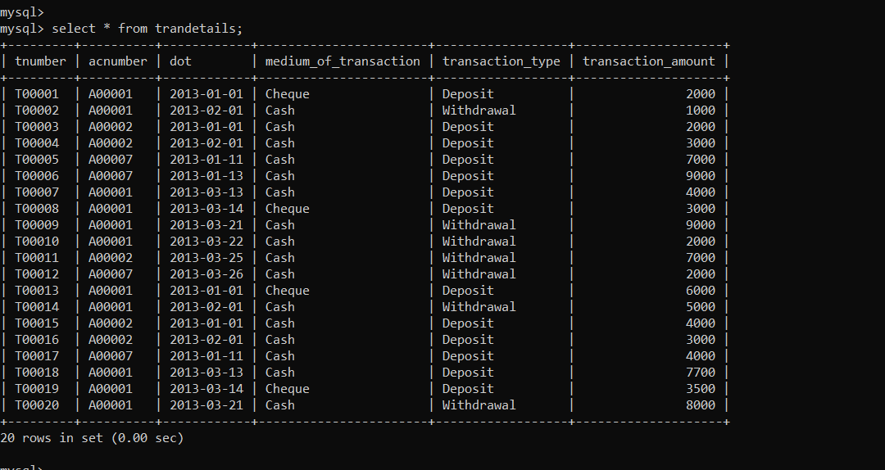
Trandetails:

Slide 15
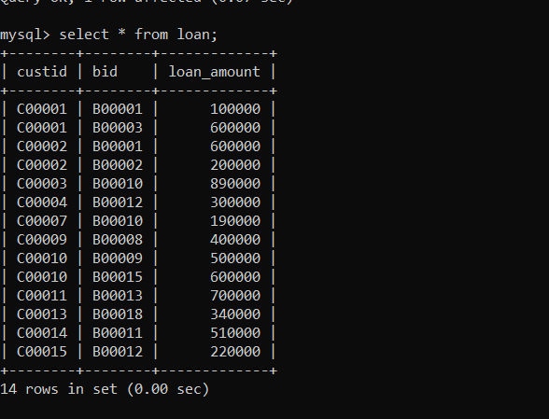
Loan:

Slide 16
SUBQUERIES:

Slide 17
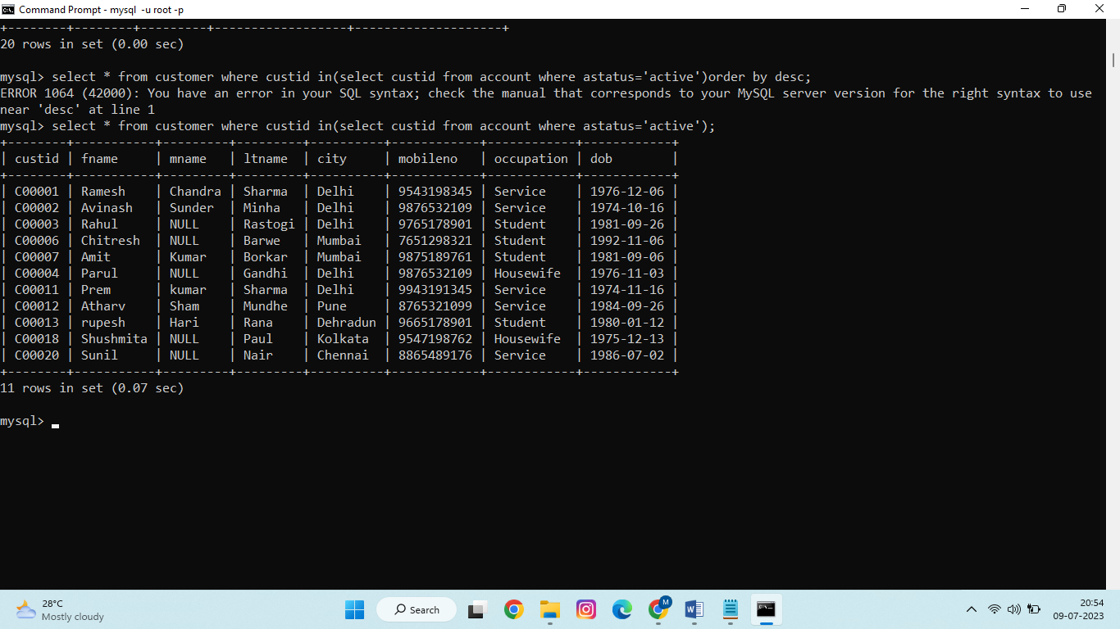
1. Display all the details of customers whose account status is active.
select * from customer where custid in(select custid from account where astatus='active');

Slide 18
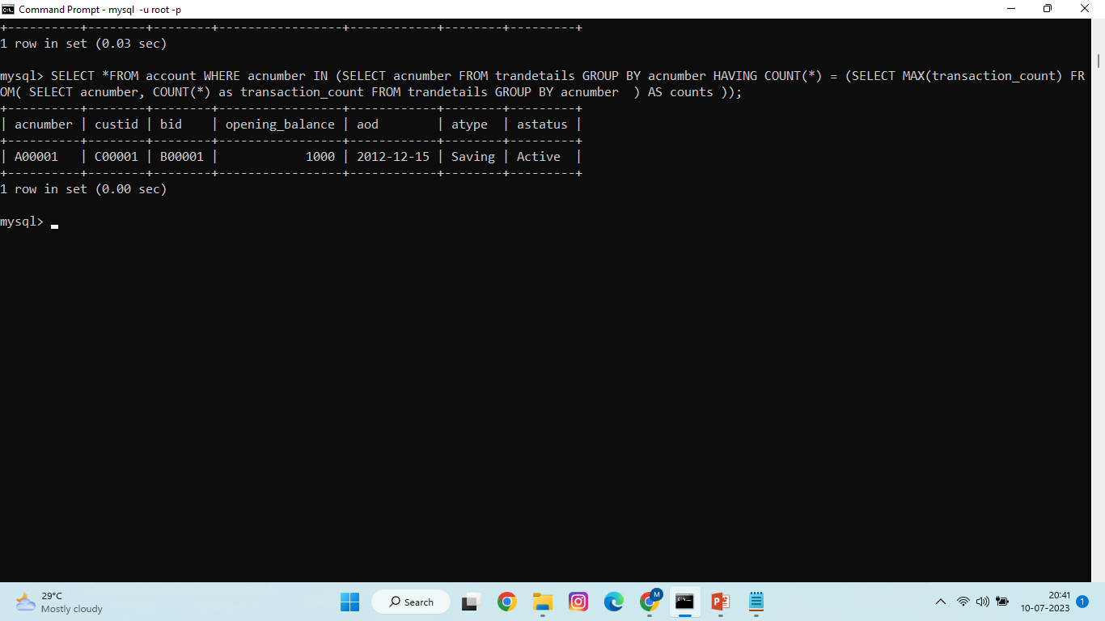
write subquery to display customers details who did most transactions.
SELECT *FROM account WHERE acnumber IN (SELECT acnumber FROM trandetails GROUP BY acnumber HAVING COUNT(*) = (SELECT MAX(transaction_count) FROM( SELECT acnumber, COUNT(*) as transaction_count FROM trandetails GROUP BY acnumber ) AS counts ));

Slide 19
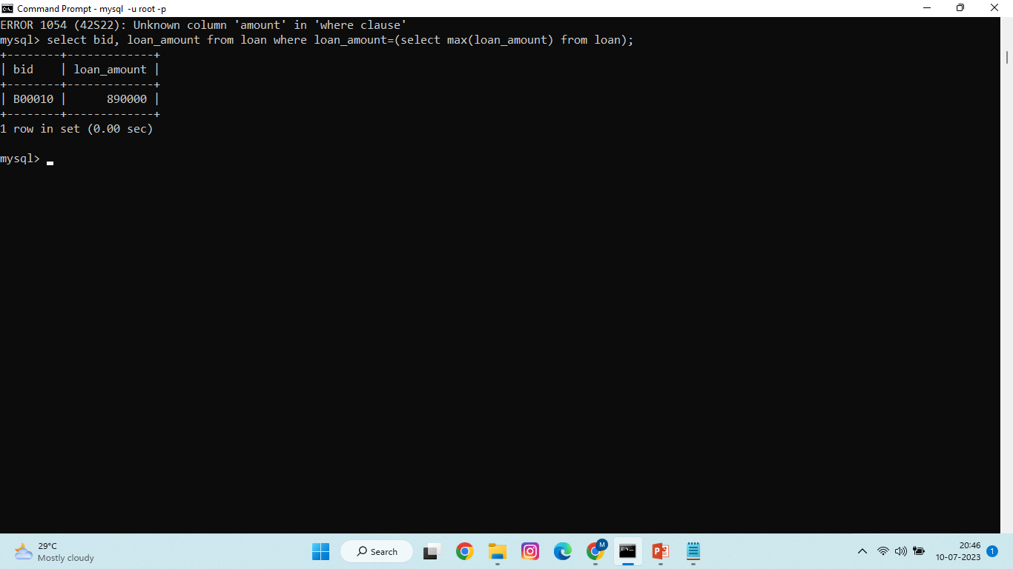
write subquery to display branch id and loan amount who has taken maximum loan
select bid, loan_amount from loan where loan_amount=(select max(loan_amount) from loan);

Slide 20
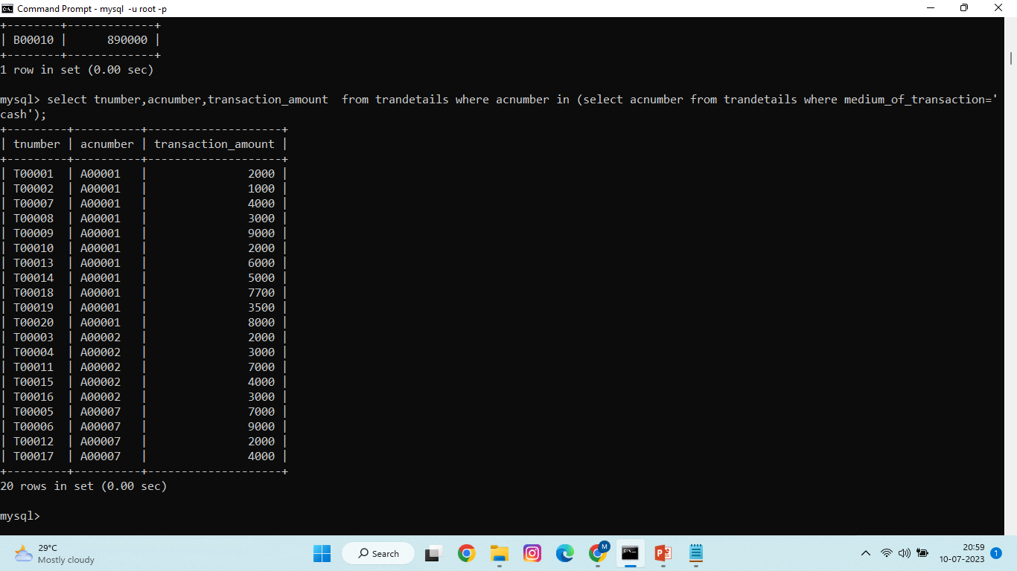
Display transaction number, account number and transaction amount whose medium of transaction is cash.
select tnumber,acnumber,transaction_amount from trandetails where acnumber in (select acnumber from trandetails where medium_of_transaction='cash');

Slide 21
JOINS:

Slide 22
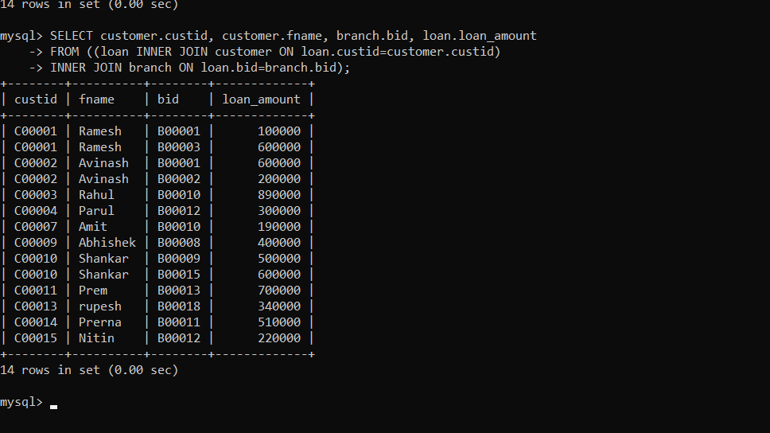
Write a query to display the customer’s number, customer’s firstname, branch id and loan amount for people who have taken loans.
SELECT customer.custid, customer.fname, branch.bid, loan.loan_amount FROM ((loan INNER JOIN customer ON loan.custid=customer.custid) INNER JOIN branch ON loan.bid=branch.bid);

Slide 23
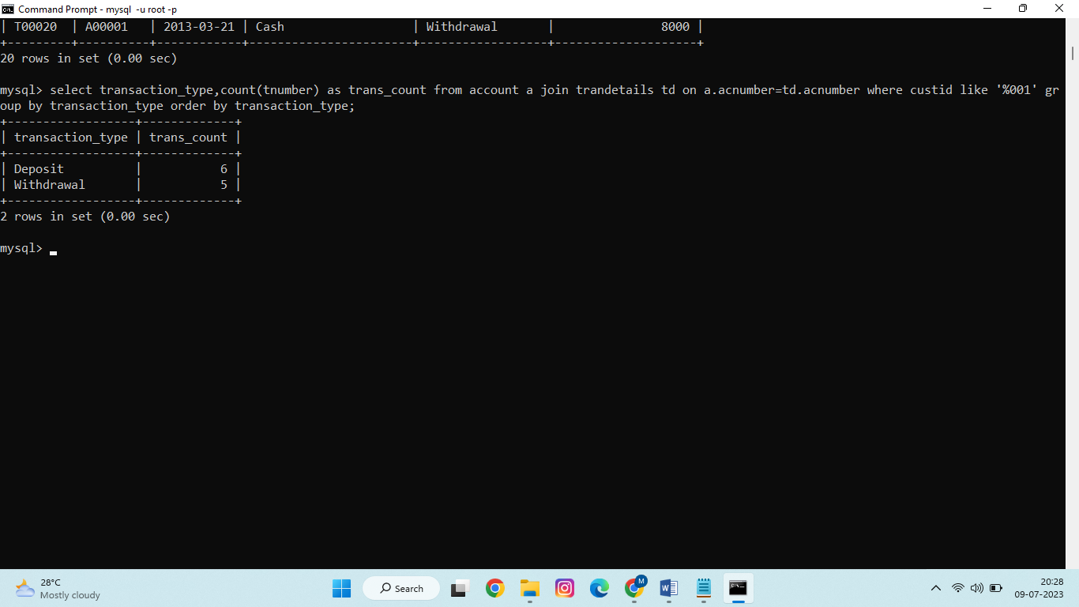
display transaction type and count of transaction number of customer whose customer id ends with 001.
select transaction_type,count (tnumber) as trans_count from account a join trandetails td on a.acnumber= td.acnumber where custid like '%001' group by transaction_type order by transaction_type;

Slide 24
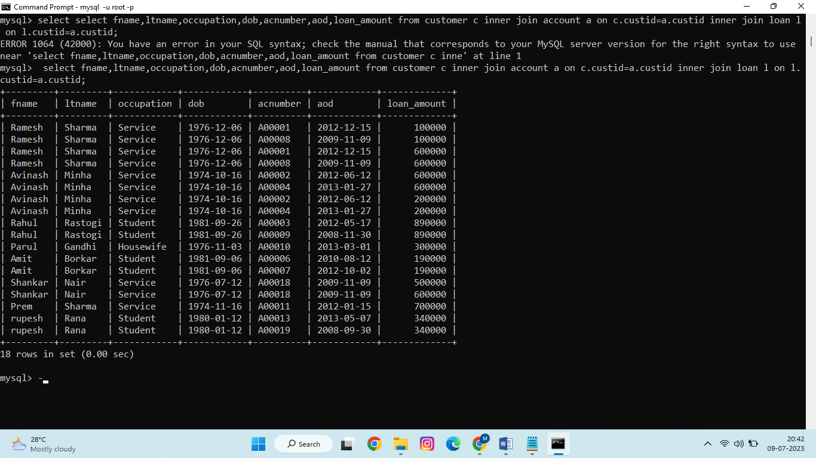
Join customer, account and loan tables and display fname,ltname,occupation,dob,acnumber,aod,loan_amount from that.
select fname,ltname,occupation,dob,acnumber,aod,loan_amount from customer c inner join account a on c.custid= a.custid inner join loan l on l.custid= a.custid;

Slide 25
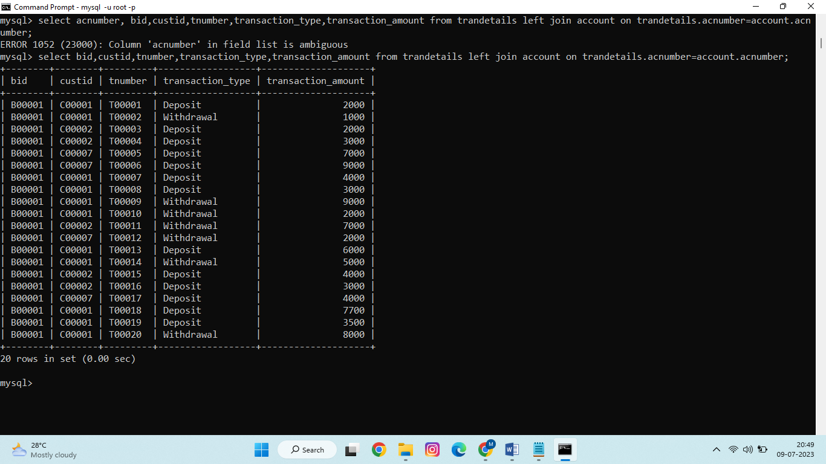
Display left join using trandetails and account.
Select bid, custid, tnumber, transaction_type, transaction_amount from trandetails left join account on trandetails.acnumber = account.acnumber;

Slide 26
THANK YOU!

